Slide 1
Our greatest glory is not in never falling, but in rising every time we fall.
– Confucius
Lecture 4 (4) – C++ Standard Library (2)
CST370 – Design & Analysis of Algorithms
Dr. Byun
Computer Science

Slide 2
Lecture Objectives
After completion of this lecture, you will be able to
  use the stack, queue, set, and map containers of the C++ standard library.

Slide 3
Stacks in STL
Important functions of a stack
  push( )
  pop( )
  top( )
Reference
  https://www.geeksforgeeks.org/stack-in-cpp-stl/

Slide 4
Exercise – Present execution result
#include <stack>
stack<int> s;
s.push(100);
s.push(200);
s.push(300);
cout << s.top() << endl;
s.pop();
cout << s.top() << endl;
s.top() = 77; // modify top element
while (!s.empty()) {
cout << s.top() << ' ';
s.pop();
}

Slide 5
Queues in STL
Important functions of a queue container
  push() (same as enqueue() in our CST238)
  pop() (same as dequeue() in our CST238)
  front() returns a reference to the first element of the queue
  back() returns a reference to the last element of the queue
Reference
  https://www.geeksforgeeks.org/queue-cpp-stl/

Slide 6
Exercise – Present execution result
#include <queue>
queue<string> q;
q.push("These ");
q.push("are ");
q.push("more than ");
cout << q.front() << endl;
q.pop();
cout << q.front() << endl;
q.pop();
q.push("four ");
q.push("words!");
cout << "Size: " << q.size() << endl;

Slide 7
Set Container
A set container stores elements without duplicates.
  Adding a duplicate of an element in a set container is ignored.

Slide 8
Two Types of Set Containers
In the C++ library, there are two types of set containers.
  1. unordered_set
  2. set
No order among elements.
Implemented using hashing.
Mathematically, order is not important in a set.
Automatically ordered when added or deleted.
Implemented using a balanced BST.

Slide 9
Example (1 of 2)
https://repl.it/@YBYUN/setSTL
int main( ) {
set<char> s;
s.insert('A'); s.insert('D');
s.insert('D'); s.insert('C');
s.insert('C'); s.insert('B');
cout << "The set contains:\n";
for (auto p = s.begin( ); p != s.end( ); p++) {
cout << *p << " ";
}
cout << endl;

Slide 10
Example (2 of 2)
cout << "Set contains 'C': ";
if (s.find('C') == s.end( )) {
cout << " no " << endl;
}
else {
cout << " yes " << endl;
}
cout << "Removing C.\n";
s.erase('C');
for (auto p = s.begin( ); p != s.end( ); p++) {
cout << *p << " ";
}
cout << endl;

Slide 11
Existence of a Value in a set
The count() function returns 1 if a value exists in a set.
Example
  set<string> courses = {"CST231", "CST238",
  "CST370", "CST438"};
  if (courses.count("CST370"))
  cout << "Found!" << endl;
  else
  cout << "Not Found!" << endl;

Slide 12
Retrieving an Element in a set
The find() function searches for an element with a specified value.
  If found, it returns an iterator to the element matching it.
  Otherwise, it returns an iterator to the end of the set.
Example
  set<string> courses = {"CST231", "CST238",
  "CST370", "CST438"};
  auto p = courses.find("CST238");
  if (p != courses.end())
  cout << *p << " was found!" << endl;

Slide 13
The unordered_set Container
The unordered_set container is similar to the set container, except in two regards:
  The values in an unordered_set are not sorted.
  The unordered_set class has better performance. Internally, it uses a hashing.

Slide 14
Hashing – Example (1 of 2)
Watch this video first
  https://youtu.be/geX6x33fKzY
  In the video, I use a theta notation like Θ. But ignore it. We will cover it soon.
Assume that you want to keep the id numbers of students in a class.
  The numbers are in the range of 0 to 9999.
Main operations you want to do are
  Search an id number.
  Insert a new id number.
  Delete an id number.

Slide 15
Hashing – Example (2 of 2)
Insert two numbers 1234 and 2000.
index
content
0
1
…
34
…
99
Sample Hash Table

Slide 16
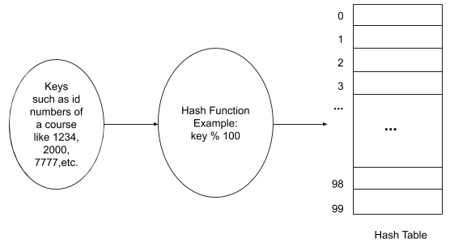
Hash Table and Hash Function for Hashing

Slide 17
Puzzle
Assume that an array holds positive and negative numbers mixed.
  How can you put all negative numbers first and then positive numbers later?

Slide 18
Solution

Slide 19
Map Container
A map is an associative container.
  An associative containers hold <key, value> pairs.
Each element in a map has a key and its associated value.
  You use a key to retrieve a value that is associated with the key.
  A key should be unique (= no duplicates).

Slide 20
Map Container – Key/Value Pairs
Example
  Key: Student’s ID number.
  Value: Student’s academic record.
Another example
  Key: Vehicle license plate
  Value: Vehicle information such as the owner, color, maker, etc.
One more example
  Key: ZIP code.
  Value: City name.

Slide 21
Two Types of Map Containers
In the C++ library, there are two types of map containers.
  1. unordered_map
  2. map
Keys are unordered.
Implemented using the hashing
Keys are ordered.
Implemented using the balanced BST.

Slide 22
Example (1 of 2)
// https://repl.it/@YBYUN/MapDemo
// Create a map containing student IDs and names.
map<int, string> students;
// [ ] operator to associate keys and values.
students[1234] = "Alice Otter";
students[7777] = "Bob Otter";
students[2000] = "Chris Smith";
// Display a value of a key
cout << "ID: 2000, Name: " << students[2000] << endl;
// Change the value of a key
students[2000] = "Chris Otter";
cout << "ID: 2000, Name: " << students[2000] << endl;

Slide 23
Example (2 of 2)
// Use the find() function to check if a key is present.
int key = 5000;
auto pos = students.find(key);
if (pos == students.end()) {
cout << "No student with ID " << key << endl;
}
else {
cout << “Student with ID " << key << endl;
}
// erase() function to remove a key/value pair
students.erase(1234);

Slide 24
The pair Type
Internally, each element of a map is stored as an instance of the pair type.
  pair is a struct that has two member variables: first and second.
  An element’s key is stored in first, and the value is stored in second.
The pair struct is declared in the <utility> header file.
  When you #include the <map> header file, <utility> is automatically included.

Slide 25
Example
// Display all elements in the map.
for (auto p = students.begin(); p != students.end(); p++) {
cout << "ID: " << p->first
<< "\tName: " << p->second << endl;
}

Slide 26
insert() Member Function
The insert() function adds a pair to the map.
  You may need the make_pair() function to construct a pair for a map.
Example
  student.insert(make_pair(7777, “Eric Otter"));
  Note: If the key already exists, the insert() function will not insert the new element.

Slide 27
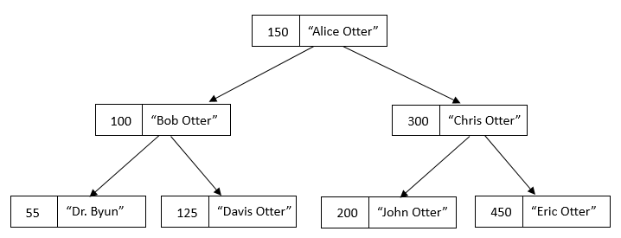
Implementation of map Container
A map container is implemented using a balanced binary search tree called a red-black tree.

Slide 28
The unordered_map Class
The unordered_map container is implemented using a hash table.
It is similar to the map container, except in two regards.
  The keys in an unordered_map are not sorted.
  The unordered_map class has better performance.

Slide 29

Vector vs. Set vs. Map

Slide 30
References
Cay Horstmann, Big C++, 3rd Edition, Wiley, 2017
Walter Savitch, Absolute C++, 6th Edition, Pearson, 2015
Tony Gaddis, Starting Out with C++ from Control Structures to Objects, 9th Edition, Pearson, 2017
Nicolai Josuttis, The C++ Standard Library: A Tutorial and Reference, 2nd Edition, Addison-Wesley Professional, 2012

